Slide 1


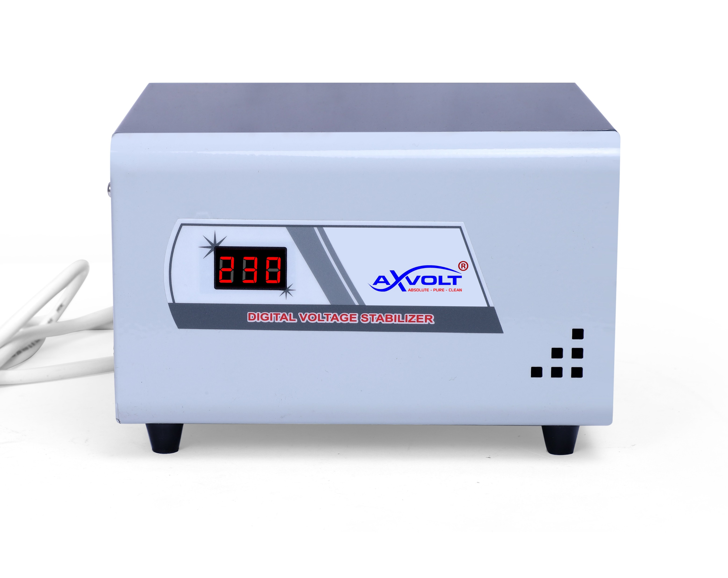


AXVOLT Grid 1 KVA Computer Voltage stabilizer with Three Output Socket

Slide 2
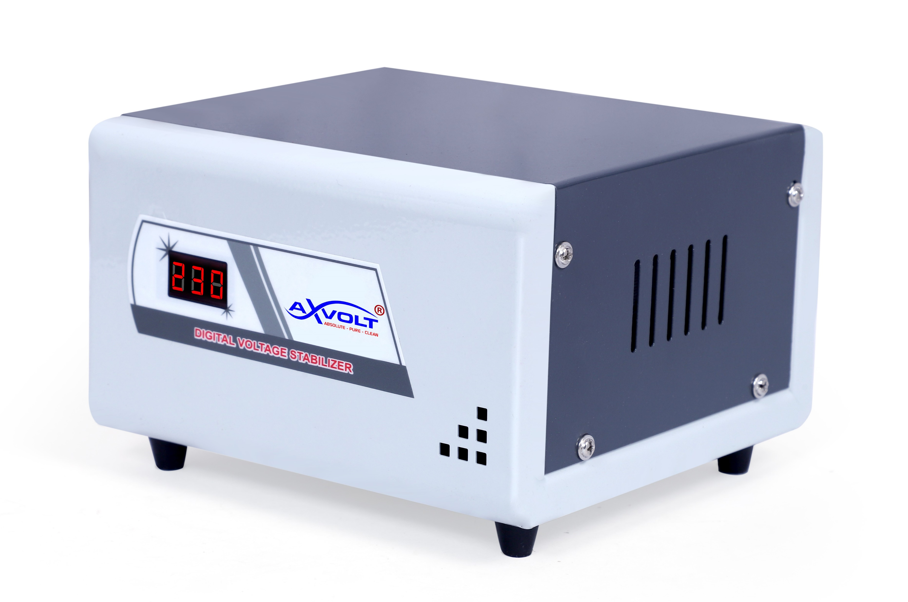


Slide 3





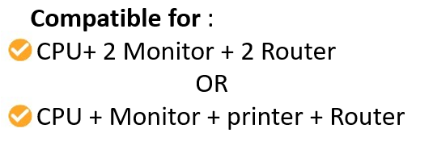

Slide 4



Dimensions of the Stabilizer

Slide 5


